Slide 1
AUTHENTICATION SCHEME FOR SESSION PASSWORD USING COLOR AND IMAGE
PRESENTDED BY
R.Nikila
M.Nivetha

Slide 2
OVERVIEW
Abstract
Introduction
Existing system
Proposed system
System architecture
Modules
Screen shots
Conclusion
References

Slide 3
ABSTRACT
Textual passwords are most common method used for authentication
Graphical passwords are introduced as alternative techniques to textual passwords
Two techniques are proposed to generate session passwords using text and colors

Slide 4
INTRODUCTION
The text password is primary authentication for websites
To log into the website, users must recall the selected passwords
The password based user authentication is major problem for memorizing text strings
The user choose easy to remember passwords

Slide 5
EXISTING SYSTEM
Users select weak passwords and reuse the same passwords across different websites
Typing passwords into untrusted computers suffers password thief threat
Password-based user authentication can resist brute force and dictionary attacks

Slide 6
PROPOSED SYSTEM
The user authentication protocol named OPASS
OPASS requires each participating website possesses a unique phone number
Users only need to remember a long-term password for login all websites

Slide 7
SYSTEM ARCHITECTURE

Slide 8
REQUIREMENTS
SOFTWARE REQUIREMENTS
Front End/GUI Tool : Microsoft Visual studio 2008
Operating System : Windows Family
Language : C#.NET
Application : Windows Application
Back End : SQL SERVER 2005

Slide 9
CONTD.,
HARDWARE REQUIREMENTS
Processor : Pentium dual core
RAM : 1 GB
Hard Disk Drive : 80 GB
Monitor : 17” Color Monitor

Slide 10
MODULES
Enrollment Phase
Client verification
Server verification
Accessing service

Slide 11
ENROLLMENT PHASE
The phase is to allow a user and a server to authenticate succeeding login
User begins the OPASS program installed on cell phone

Slide 12

SERVER VERIFICATION
Server can decrypt and verify the authenticity of the registration SMS.
User use cell phone to produce a one-time password e.g., deliver information encrypted to server via SMS message.

Slide 13
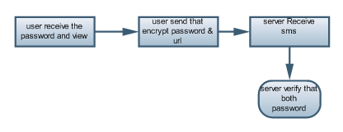
CLIENT VERIFICATION
The mobile program sends ID and ID to the TSP
It received the ID and trace the user’s phone number
The login phase begins the user sends a request to the server

Slide 14
ACCESSING SERVICE
User enter the browser and Register to server then server encrypt password to mobile
User receive the SMS and send to server then server verify both password

Slide 15
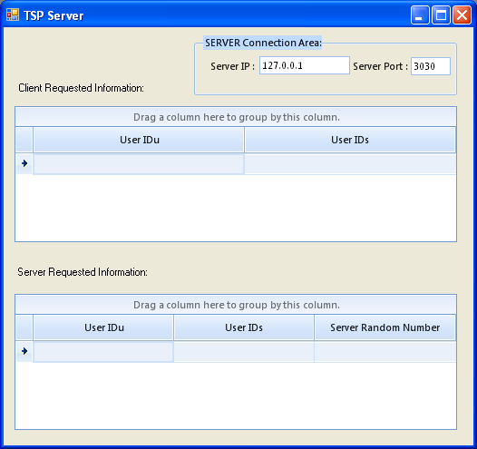
SCREEN SHOTS
TSP SERVER

Slide 16
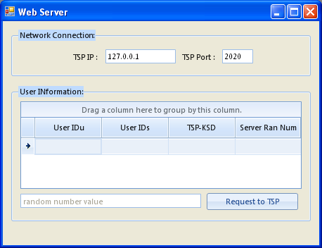
WEB SERVER

Slide 17
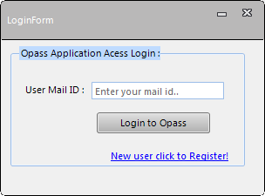
OPASS APPLICATION

Slide 18
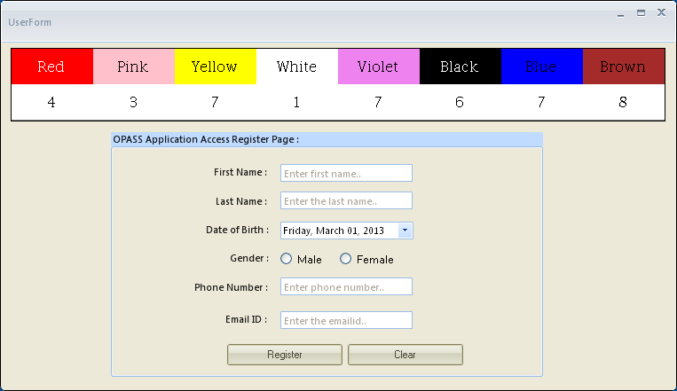
OPASS NEW USER REGISTRATION

Slide 19
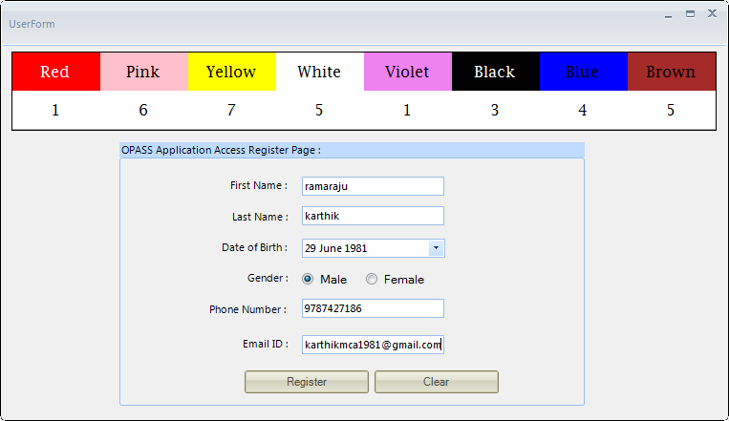
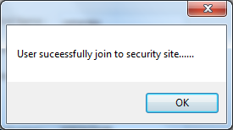

Slide 20
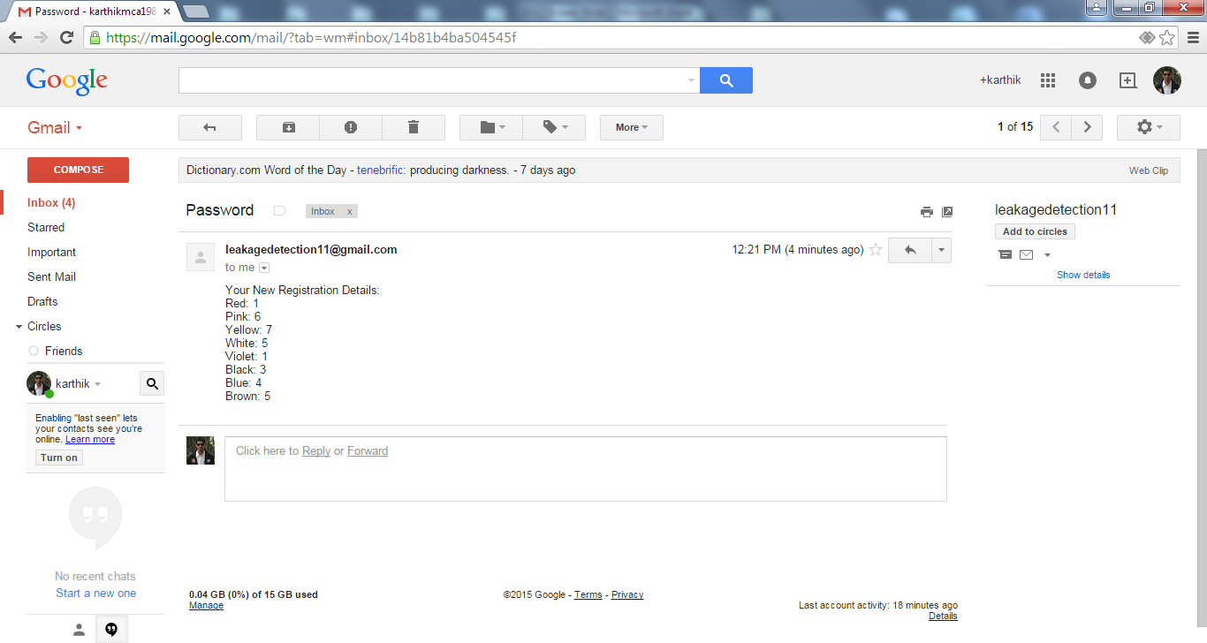
OPASS PASSWORD RECEIVED FROM USER MAIL

Slide 21
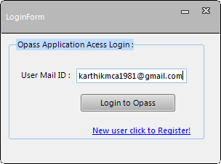
USER LOGIN INTO OPASS APPLICATION

Slide 22
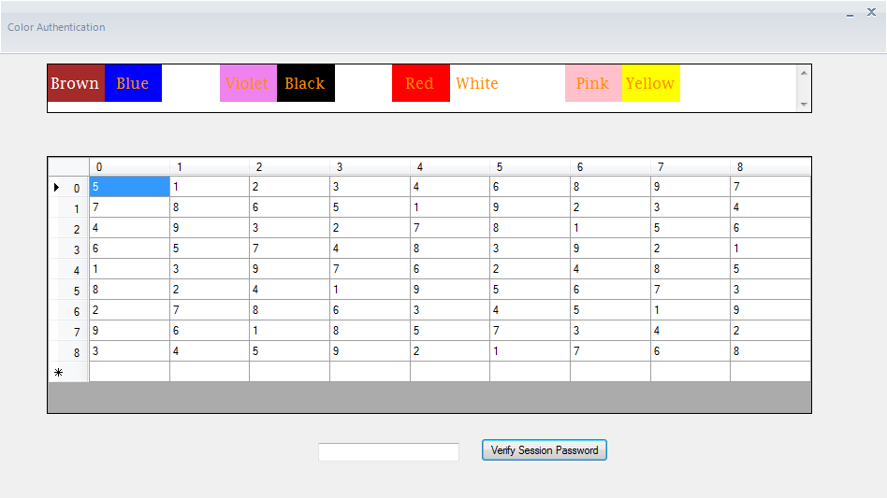
USER PASSWORD ENTERING PAGE

Slide 23
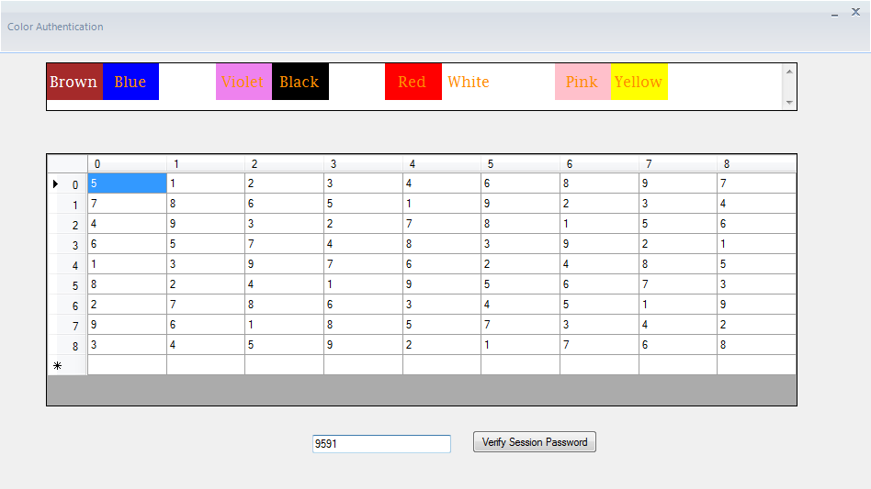

Slide 24
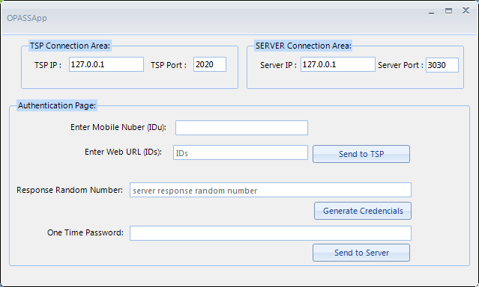
USER AFTER CLICKING VERIFY SESSION PASSWORD

Slide 25
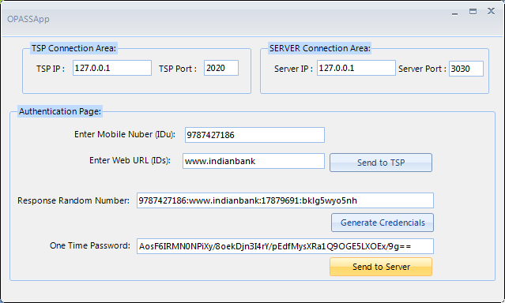
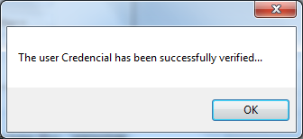

Slide 26
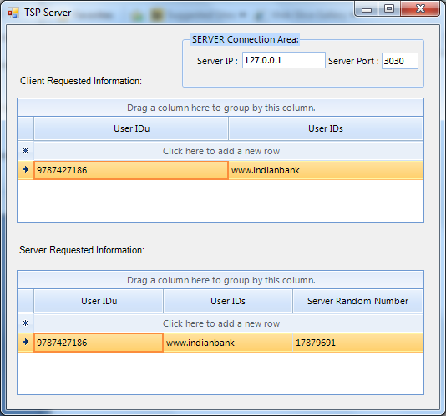
TSP SERVER

Slide 27
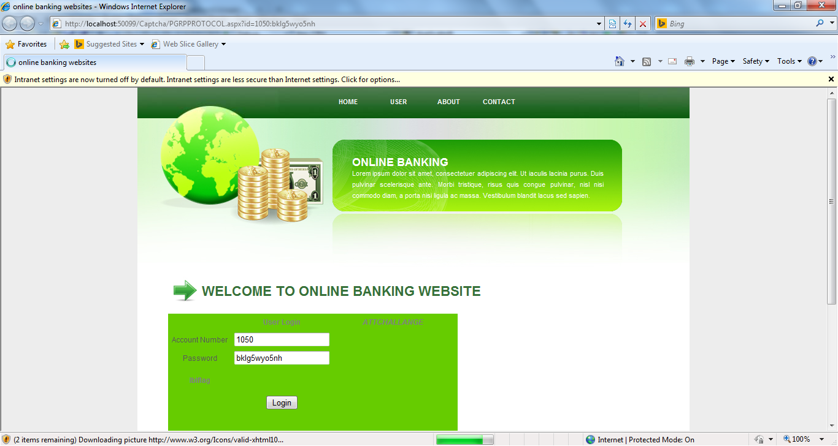
BANKING WEBSITE LOGIN PAGE USERNAME PASSWORD AUATOMATICALLY GET FROM SERVER

Slide 28
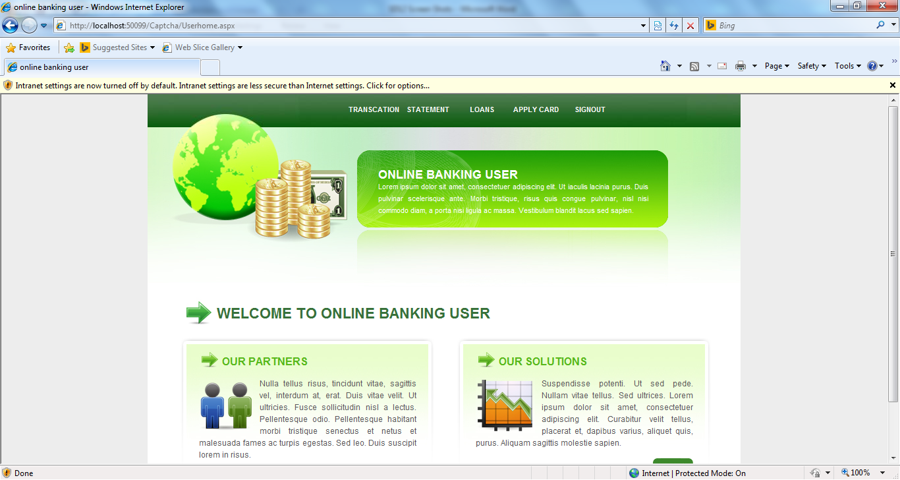
BANKING WEBSITE MAIN PAGE

Slide 29
CONCLUSION
OPASS eliminates the negative influence of human factors
User needs to remember a long-term password
It adopts the one-time password approach to ensure independence between each login
OPASS fully functional, password recovery is also considered and supported when users lose their cell phones

Slide 30
REFERENCES
Chiasson, S. Forget, A. Stobert,S. van Oorschot, E.P.C. and Biddle, R.(2009)“Multiple password interference in text passwords and click-based graphical passwords,”
Florencio, D. and Herley, C.(2007)“A large-scale study of web password habits,”
Gawand, S. Felten, E.W. (2006) “Password management strategies for online accounts” in SOUPS

Slide 31
CONTD.,
Ives, B. Walsh, K.R. and Schneider, H. (2004) “The domino effect of password reuse”.
Perrig, A. and Song, D.(1999) “Hash visualization A new technique to improve real-world security,”.
Thorpe, J. and van Oorschot, P.(2004) “Towards secure design choices for implementing graphical passwords,” in Computer Security Applicat. Conf.

Slide 32
THANK YOU

